Slide 1
Help Wanted Online
A real-time measure of job postings
June 2022
Office of Research
Connecticut Department of Labor
Connecticut Department of Labor – Research Office
200 Folly Brook Blvd.
Wethersfield, CT 06109
Help Wanted Online

Slide 2
What is HWOL?
The Conference Board Help Wanted Online® Data Series (HWOL) measures the number of new, first-time Online job postings and jobs reposted from the previous month for over 50,000 Internet job boards, corporate boards and smaller job sites that serve niche markets and smaller geographic areas.
Connecticut Department of Labor – Research Office
200 Folly Brook Blvd.
Wethersfield, CT 06109
Help Wanted Online

Slide 3
Upcoming Release Dates
Monthly Report:
Friday, July 15th, 2022
Weekly New Ads Report:
Updated every Friday
Connecticut Department of Labor – Research Office
200 Folly Brook Blvd.
Wethersfield, CT 06109
Help Wanted Online

Slide 4
Statewide Weekly New Job Ads
Weekly New job postings was 6,847 during the week ending 6/04/22.
Connecticut Department of Labor – Research Office
200 Folly Brook Blvd.
Wethersfield, CT 06109
Help Wanted Online

Slide 5
HWOL New Weekly Industry Job Ads – CT Statewide
Connecticut Department of Labor – Research Office
200 Folly Brook Blvd.
Wethersfield, CT 06109
Help Wanted Online

Slide 6
Connecticut Department of Labor – Research Office
200 Folly Brook Blvd.
Wethersfield, CT 06109
Help Wanted Online

Slide 7
Employers with the Most New Job Postings
Connecticut Department of Labor – Research Office
200 Folly Brook Blvd.
Wethersfield, CT 06109
Help Wanted Online

Slide 8
Monthly HWOL Information
The following pages contain HWOL monthly data for May 2022.
Monthly and weekly job ad information can be found here:
https://www1.ctdol.state.ct.us/lmi/HWOL.asp
Connecticut Department of Labor – Research Office
200 Folly Brook Blvd.
Wethersfield, CT 06109
Help Wanted Online

Slide 9
Statewide Highlights
- Total postings in Connecticut was 106,633 in May 2022, Up 8% from April 2022.
-Industry sectors with the most job postings were Health Care and Social Assistance (18,829 postings), Finance and Insurance (11,487 posting), Retail Trade (9,607 postings), and Manufacturing (8,750 postings).
-Occupations with the most postings were Registered Nurses (4,499 postings), Retail Salespersons (2,865 postings), Wholesale & Manufacturing Sales Representatives (2,288 postings), and Heavy & Tractor-Trailer Truck Drivers (2,258 postings).
Connecticut Department of Labor – Research Office
200 Folly Brook Blvd.
Wethersfield, CT 06109
Help Wanted Online

Slide 10
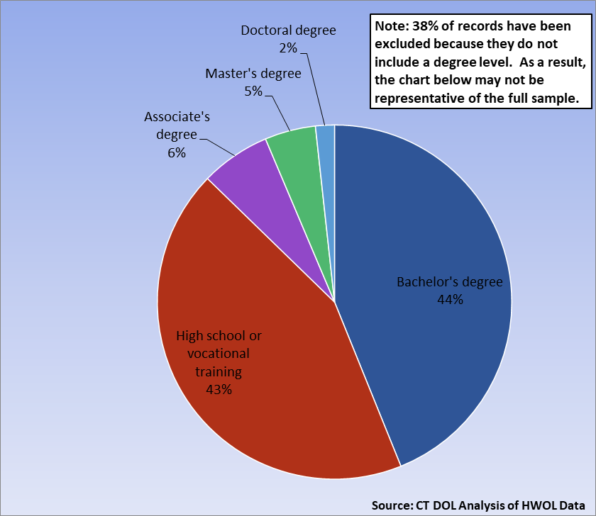
Connecticut Job Ads by Educational Requirements
Connecticut Department of Labor – Research Office
200 Folly Brook Blvd.
Wethersfield, CT 06109
Help Wanted Online

Slide 11
Top Certifications in Connecticut Job Ads
Connecticut Department of Labor – Research Office
200 Folly Brook Blvd.
Wethersfield, CT 06109
Help Wanted Online

Slide 12
Top Skills in Connecticut Job Ads
Connecticut Department of Labor – Research Office
200 Folly Brook Blvd.
Wethersfield, CT 06109
Help Wanted Online

Slide 13
Top Skills by Industry in Connecticut Job Ads
Connecticut Department of Labor – Research Office
200 Folly Brook Blvd.
Wethersfield, CT 06109
Help Wanted Online

Slide 14
Top Skills by Industry in Connecticut Job Ads (Continued)
Connecticut Department of Labor – Research Office
200 Folly Brook Blvd.
Wethersfield, CT 06109
Help Wanted Online

Slide 15
Connecticut Department of Labor – Research Office
200 Folly Brook Blvd.
Wethersfield, CT 06109
Help Wanted Online

Slide 16
Connecticut Employers with the Most Job Ads
Connecticut Department of Labor – Research Office
200 Folly Brook Blvd.
Wethersfield, CT 06109
Help Wanted Online

Slide 17
Connecticut Occupations with the Most Job Ads
Connecticut Department of Labor – Research Office
200 Folly Brook Blvd.
Wethersfield, CT 06109
Help Wanted Online

Slide 18
Connecticut Job Ads by Industry and Major Occupational Group
Connecticut Department of Labor – Research Office
200 Folly Brook Blvd.
Wethersfield, CT 06109
Help Wanted Online

Slide 19
Workforce Area Data
Workforce Area Highlights
Job Ads by Industry
Job Ads by Location
Employers With The Most Job Ads
Occupations With The Most Job Ads
Connecticut Department of Labor – Research Office
200 Folly Brook Blvd.
Wethersfield, CT 06109
Help Wanted Online

Slide 20
Workforce Area Highlights
Connecticut Department of Labor – Research Office
200 Folly Brook Blvd.
Wethersfield, CT 06109
Help Wanted Online

Slide 21
Connecticut Department of Labor – Research Office
200 Folly Brook Blvd.
Wethersfield, CT 06109
Help Wanted Online

Slide 22
Eastern Workforce Job Ads by Location
Connecticut Department of Labor – Research Office
200 Folly Brook Blvd.
Wethersfield, CT 06109
Help Wanted Online

Slide 23
Eastern Workforce Employers
with the Most Job Ads
University of Connecticut
William W. Backus Hospital
Masonicare Corporation
Natchaug Hospital Incorporated
State of Connecticut
Charles River Laboratories
Compass Group North America
Rogers Corporation
Mohegan Sun
Capital One
CVS Health
Generations Family Health Center
UnitedHealth Group
Sonalysts Incorporated
Springhill Suites
Groton Public Schools
Panera Bread
Page Taft Compass
Girl Scounts of Connecticut
General Dynamics
Pfizer
Day Kimball Healthcare
Department Administrative Services
Walgreens Boots Alliance Inc
Walmart / Sam's
Staples
Norwich Public Schools
Windham Hospital
Dell
FedEx
PepsiCo Inc.
Asplundh Tree Expert Company
Mashantucket Pequot Gaming
Lowe's Companies, Inc
Healthpro Heritage
Aveanna Healthcare
BJ's Wholesale Club, Inc.
Allied Universal
Connecticut Department of Labor – Research Office
200 Folly Brook Blvd.
Wethersfield, CT 06109
Help Wanted Online

Slide 24
Eastern Workforce Occupations
with the Most Job Ads
Connecticut Department of Labor – Research Office
200 Folly Brook Blvd.
Wethersfield, CT 06109
Help Wanted Online

Slide 25
Connecticut Department of Labor – Research Office
200 Folly Brook Blvd.
Wethersfield, CT 06109
Help Wanted Online
25

Slide 26
North Central WDA Job Ads by Location
Connecticut Department of Labor – Research Office
200 Folly Brook Blvd.
Wethersfield, CT 06109
Help Wanted Online

Slide 27
North Central WDA Employers
with the Most Job Ads
Capital One
Hartford Hospital
State Connecticut
CVS Health
Disney
KPMG
Pratt & Whitney
Walmart / Sam's
Eversource Energy
PricewaterhouseCoopers
Sysco Corporation
Greater Hartford YMCA
Trinity Health
Stanley Black & Decker
Lincoln Financial Group
Quest Global
Pearson
Bank of America
East Hartford Public Schools
Raytheon
UnitedHealth Group
Cigna Corporation
Travelers
Accenture
The Hartford Financial Group
Wheeler Clinic
Connecticut Children's Medical Center
Walgreens Boots Alliance Inc
ECHN
Connectrn
Allied Universal
EverSource
Amazon
University of Connecticut
The Home Depot Incorporated
Panera Bread
Deloitte
Aya Healthcare
Connecticut Department of Labor – Research Office
200 Folly Brook Blvd.
Wethersfield, CT 06109
Help Wanted Online

Slide 28
North Central WDA Occupations
with the Most Job Ads
Connecticut Department of Labor – Research Office
200 Folly Brook Blvd.
Wethersfield, CT 06109
Help Wanted Online

Slide 29
Connecticut Department of Labor – Research Office
200 Folly Brook Blvd.
Wethersfield, CT 06109
Help Wanted Online

Slide 30
Northwest WDA Job Ads by Location
Connecticut Department of Labor – Research Office
200 Folly Brook Blvd.
Wethersfield, CT 06109
Help Wanted Online

Slide 31
Northwest WDA Employers
with the Most Job Ads
Boehringer Ingelheim
Waterbury Hospital
Walgreens Boots Alliance Inc
Trinity Health
Post University
United Parcel Service Incorporated
O'Reilly Automotive Inc
BJ's Wholesale Club, Inc.
Starbucks Coffee Company
Bozzuto
Actalent
Amazon
TJX Companies, Inc.
LHC Group
Schaeffler Group
Realogy Franchise Group LLC
The Home Depot Incorporated
Naugatuck Public Schools
United States Xpress Enterprises
Capital One
Nuvance Health
Dell
Walmart / Sam's
Devereux Advanced Behavioral Health
UnitedHealth Group
Fuelcell Energy Inc
Kyndryl
CDM Smith
Charlotte Hungerford Hospital
CVS Health
Community Health Center Association Of Connecticut
Iqvia
Allied Universal
Compass Group North America
Benchmark Senior Living
Ethan Allen
State of Connecticut
Connecticut Department of Labor – Research Office
200 Folly Brook Blvd.
Wethersfield, CT 06109
Help Wanted Online

Slide 32
Northwest WDA Occupations
with the Most Job Ads
Connecticut Department of Labor – Research Office
200 Folly Brook Blvd.
Wethersfield, CT 06109
Help Wanted Online

Slide 33
Connecticut Department of Labor – Research Office
200 Folly Brook Blvd.
Wethersfield, CT 06109
Help Wanted Online

Slide 34
South Central WDA Job Ads by Location
Connecticut Department of Labor – Research Office
200 Folly Brook Blvd.
Wethersfield, CT 06109
Help Wanted Online

Slide 35
South Central WDA Employers
with the Most Job Ads
Yale University
Capital One
Walgreens Boots Alliance Inc
Alexion Pharmaceuticals
University of New Haven
Masonicare Corporation
Raytheon
Page Taft Compass
Quinnipiac University
United Parcel Service Incorporated
O'Reilly Automotive Inc
CVS Health
Lowe's Companies, Inc
Southern Connecticut State University
Starbucks Coffee Company
A R Mazzotta Employment
Genesis Healthcare Corporation
Amazon
Liberty Bank
Yale-New Haven Health System
Anthem Blue Cross
Walmart / Sam's
Medtronic
Avangrid
UnitedHealth Group
Middlesex Health System Incorporated
State of Connecticut
Marrakech Incorporated
Midstate Medical Center
Department of Veterans Affairs
Dell
Marrakech
Ametek Incorporated
Wesleyan University
Gaylord Hospital
The Home Depot Incorporated
Michaels Arts and Crafts
Honeywell
Connecticut Department of Labor – Research Office
200 Folly Brook Blvd.
Wethersfield, CT 06109
Help Wanted Online

Slide 36
South Central WDA Occupations
with the Most Job Ads
Connecticut Department of Labor – Research Office
200 Folly Brook Blvd.
Wethersfield, CT 06109
Help Wanted Online

Slide 37
Connecticut Department of Labor – Research Office
200 Folly Brook Blvd.
Wethersfield, CT 06109
Help Wanted Online

Slide 38
Southwest WDA Job Ads by Location
Connecticut Department of Labor – Research Office
200 Folly Brook Blvd.
Wethersfield, CT 06109
Help Wanted Online

Slide 39
Southwest WDA Employers
with the Most Job Ads
Charter Communications
Capital One
PricewaterhouseCoopers
Deloitte
Stamford Hospital
Asml Holding N V
Greenwich Public Schools
Synchrony
Walgreens Boots Alliance Inc
Allied Universal
Synchrony Financial
Griffin Health Services Corporation
Discovery Behavioral Health
CDM Smith
HEI Hotels & Resorts
Coopersurgical
Sunrise Senior Living, Inc.
Sacred Heart University
Walmart / Sam's
Humana
Yale-New Haven Health System
Lockheed Martin Corporation
KPMG
Norwalk Public School District
St. Vincent's Health Service
Compass Group North America
Pitney Bowes
Ttec
Whole Foods Market, Inc.
Asml United States Incorporated
Humanity
Dell
Gartner Incorporated
Starbucks Coffee Company
NBC
Norwalk Public Schools
World Wrestling Entertainment
Benchmark Senior Living
Connecticut Department of Labor – Research Office
200 Folly Brook Blvd.
Wethersfield, CT 06109
Help Wanted Online

Slide 40
Southwest WDA Occupations
with the Most Job Ads
Connecticut Department of Labor – Research Office
200 Folly Brook Blvd.
Wethersfield, CT 06109
Help Wanted Online

Slide 41
All advertisement data used in this publication is from the Conference Board’s Help Wanted Online data series.
For more information or data requests, contact
Matthew Krzyzek in the Office of Research at the Department of Labor.
Matthew.Krzyzek@ct.gov
For more Connecticut Labor Market Information visit:
www.ctdol.state.ct.us/lmi
https://www.facebook.com/ctlmi
Twitter: @DOL_Research
Connecticut Department of Labor – Research Office
200 Folly Brook Blvd.
Wethersfield, CT 06109
Help Wanted Online

